Slide 1
Backtracking Algorithms
Topic 4 Discussion 2
Ryan Coon

Slide 2
Backtracking
Backtracking is an algorithmic-technique for solving problems recursively by trying to build a solution incrementally, one piece at a time, removing those solutions that fail to satisfy the constraints of the problem at any point of time (by time, here, is referred to the time elapsed till reaching any level of the search tree).

Slide 3
8 Queen Problem
You are given an 8x8 chessboard, find a way to place 8 queens such that no queen can attack any other queen on the chessboard. A queen can only be attacked if it lies on the same row, or same column, or the same diagonal of any other queen.
To solve this problem, we will make use of the Backtracking algorithm. The backtracking algorithm, in general checks all possible configurations and test whether the required result is obtained or not. For the given problem, we will explore all possible positions the queens can be relatively placed at. The solution will be correct when the number of placed queens = 8.
The time complexity of this approach is O(N!).

Slide 4
8 Queens Problem
The idea is to place the queens one after the other in columns, and check if previously placed queens cannot attack the current queen we're about to place. If we find such a row, we return true and put the row and column as part of the solution matrix. If such a column does not exist, we return false and backtrack.

Slide 5
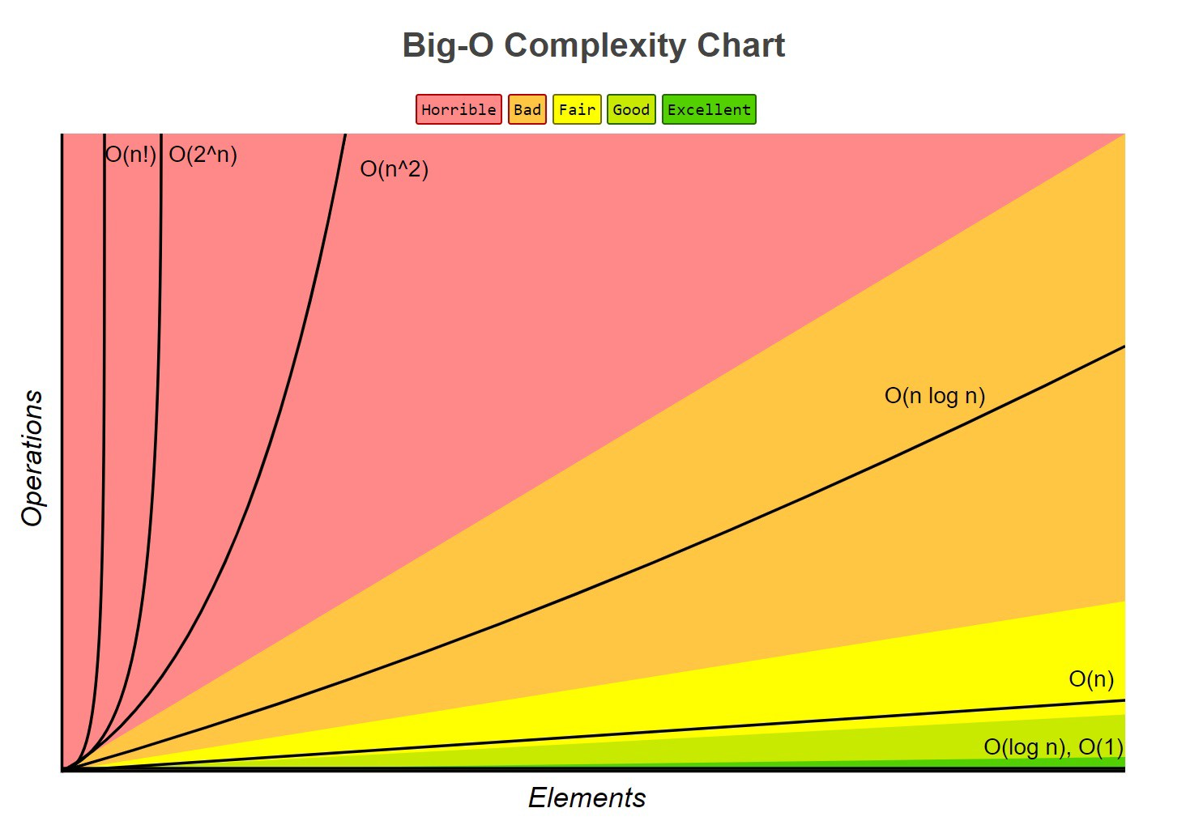
Big O Analysis
Backtracking
Runs in O(n!) time complexity.

